Slide 1
Recent Progress on Derandomizing Space-Bounded Computation (Survey)
November 27, 2023 @ Institute for Advanced Study
William Hoza
University of Chicago

Slide 2
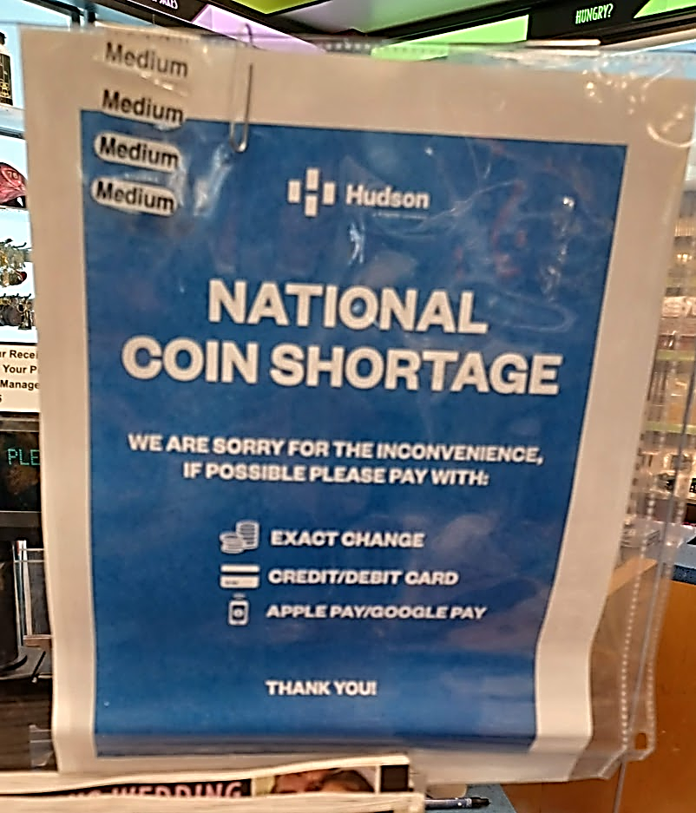


Coins are costly
Randomness is an expensive computational resource
Like time or space
Using less randomness is better than using more randomness

Slide 3
😢
🙂
😄
No known efficient algorithm
Efficient randomized algorithm
Efficient deterministic algorithm

Slide 4

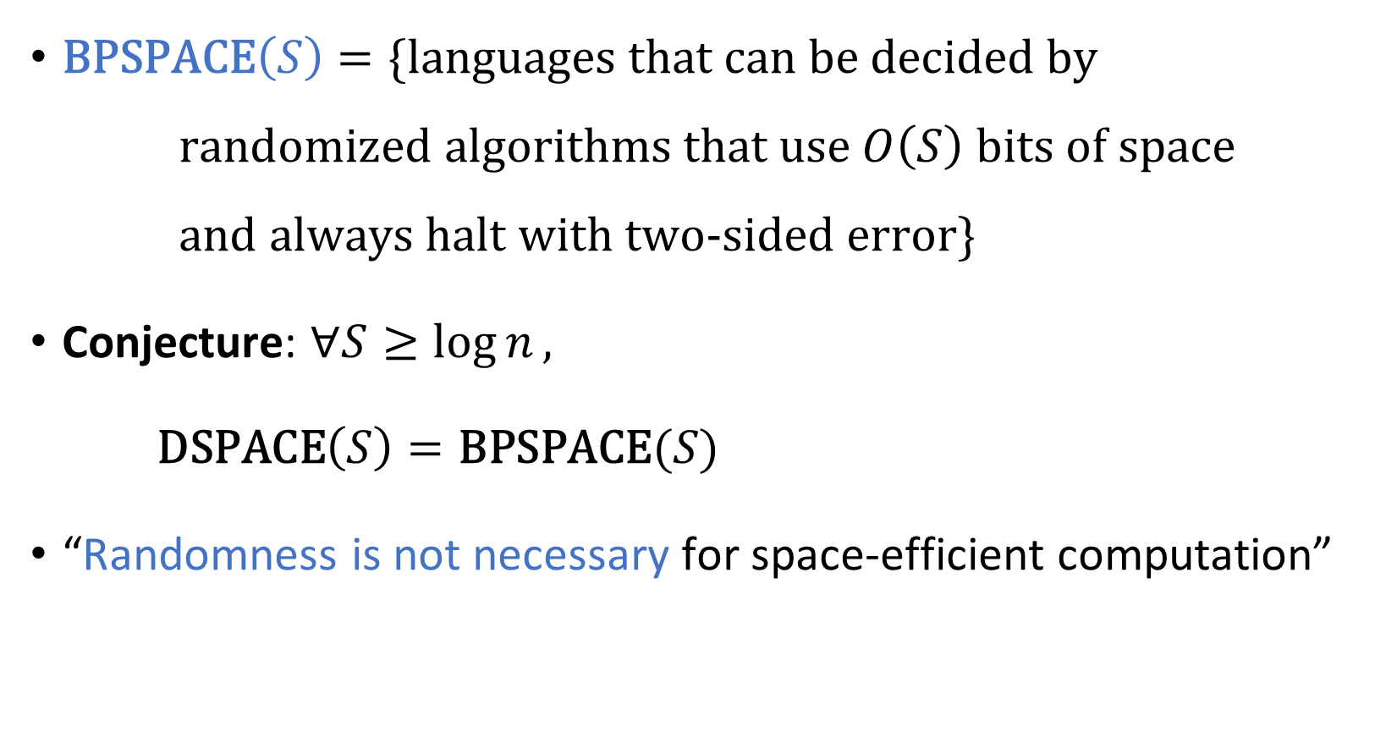
Power of randomness?
$\text{BPSPACE}\left(S\right)=\{\text{languages} \text{that} \text{can} \text{be} \text{decided} \text{by}$ $\text{randomized} \text{algorithms} \text{that} \text{use} O\left(S\right) \text{bits} \text{of} \text{space}$ $\text{and} \text{always} \text{halt} \text{with} \text{two}\text{‑}\text{sided} \text{error}\}$
Conjecture: $∀S≥\log{n},$
$\text{DSPACE}\left(S\right)=\text{BPSPACE}(S)$
“Randomness is not necessary for space-efficient computation”

Slide 5
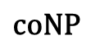
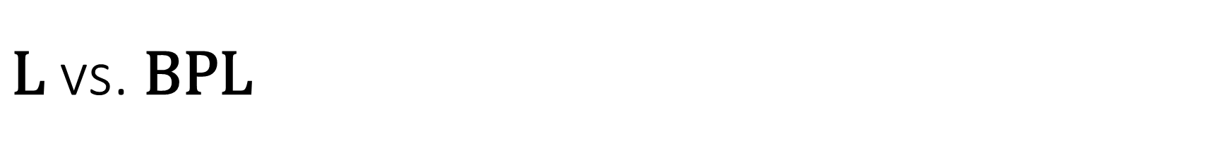

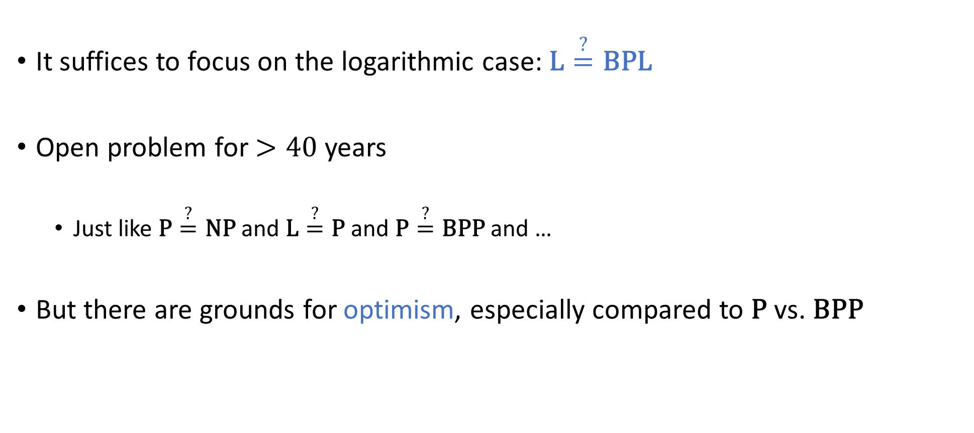
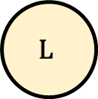
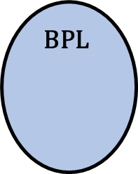
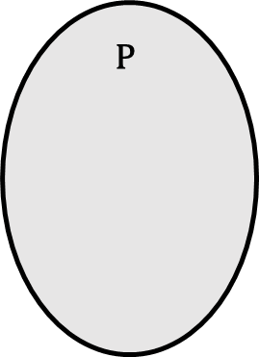
$\text{L}$ vs. $\text{BPL}$
$$\text{NP}$$
$$\text{coNP}$$
It suffices to focus on the logarithmic case: $\text{L}\overset{?}{=}\text{BPL}$
Open problem for $>40$ years
Just like $\text{P}\overset{?}{=}\text{NP}$ and $\text{L}\overset{?}{=}\text{P}$ and $\text{P}\overset{?}{=}\text{BPP}$ and …
But there are grounds for optimism, especially compared to $\text{P}$ vs. $\text{BPP}$
$$\text{P}$$
$$\text{BPL}$$
$$\text{L}$$

Slide 6
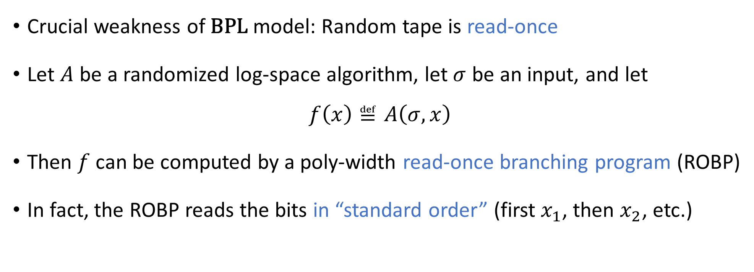
The read-once assumption
Crucial weakness of $\text{BPL}$ model: Random tape is read-once
Let $A$ be a randomized log-space algorithm, let $σ$ be an input, and let
$$f\left(x\right)≝A\left(σ, x\right)$$
Then $f$ can be computed by a poly-width read-once branching program (ROBP)
In fact, the ROBP reads the bits in “standard order” (first $x_{1}$, then $x_{2}$, etc.)

Slide 7

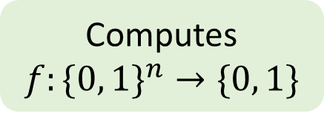
Read-once branching programs (ROBPs)
$$x=$$
$$1$$
$$0$$
$$0$$
$$1$$
$$0$$
$$1$$
Computes
$$f:\{0, 1\}^{n}→\{0, 1\}$$
0
1
acc
$$v_{\text{start}}$$
1
0
1
rej
Width $w$
0
1
1
acc
0
0
0
acc
1
rej
$n+1$ layers ($n=$ length)

Slide 8
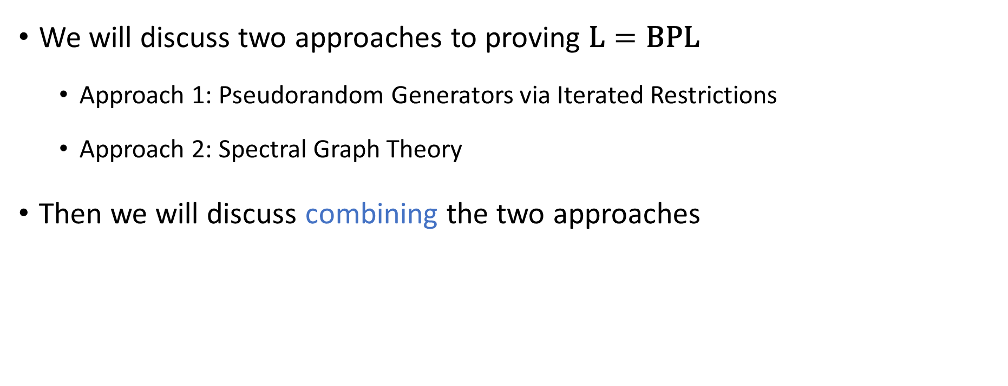
Plan for the rest of this talk
We will discuss two approaches to proving $\text{L}=\text{BPL}$
Approach 1: Pseudorandom Generators via Iterated Restrictions
Approach 2: Spectral Graph Theory
Then we will discuss combining the two approaches

Slide 9
Approach 1: Pseudorandom Generators via Iterated Restrictions

Slide 10
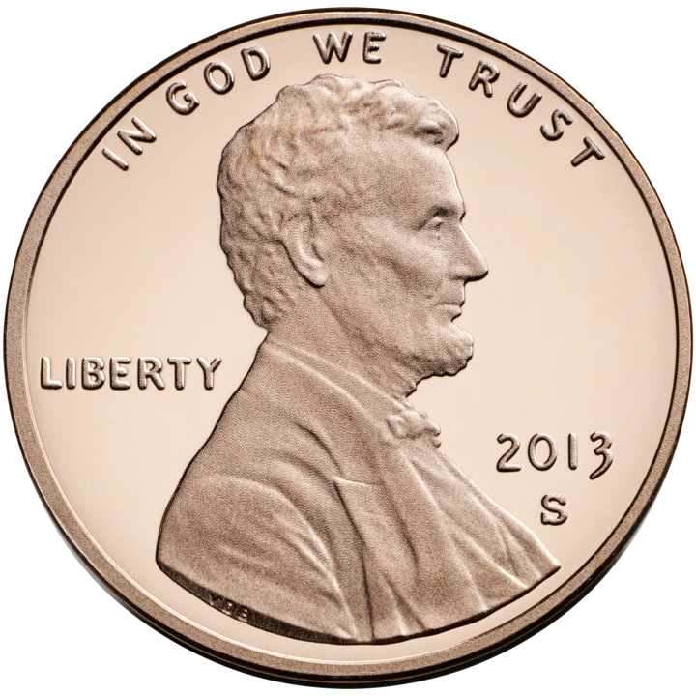

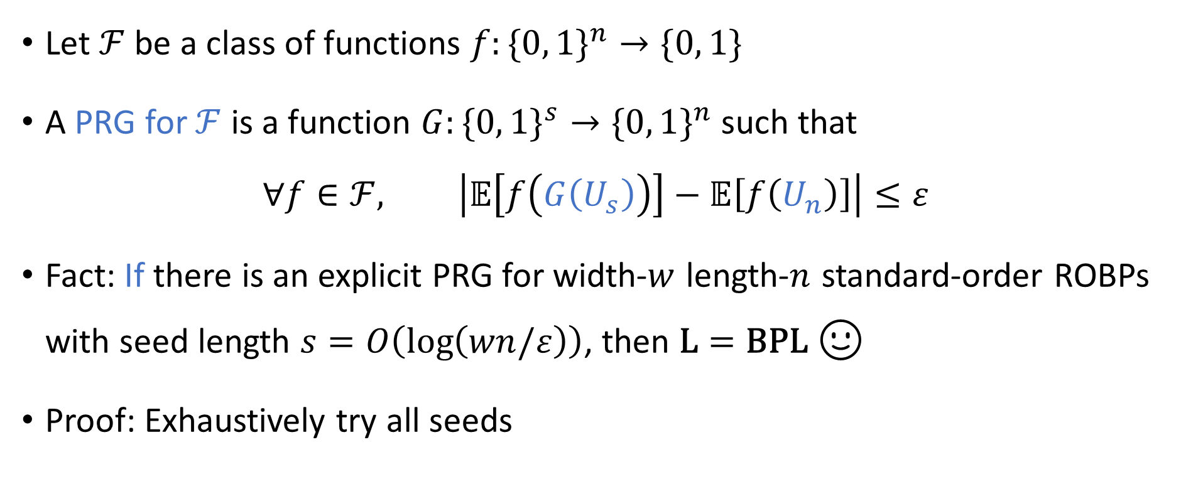
Pseudorandom generators (PRGs)
Let $ℱ$ be a class of functions $f:\{0, 1\}^{n}→\{0, 1\}$
A PRG for $ℱ$ is a function $G:\{0, 1\}^{s}→\{0, 1\}^{n}$ such that
$$∀f∈ℱ, \left|𝔼\left[f\left(G\left(U_{s}\right)\right)\right]−𝔼\left[f\left(U_{n}\right)\right]\right|≤ε$$
Fact: If there is an explicit PRG for width-$w$ length-$n$ standard-order ROBPs with seed length $s=O\left(\log\left(wn/ε\right)\right)$, then $\text{L}=\text{BPL}$ 🙂
Proof: Exhaustively try all seeds

Slide 11
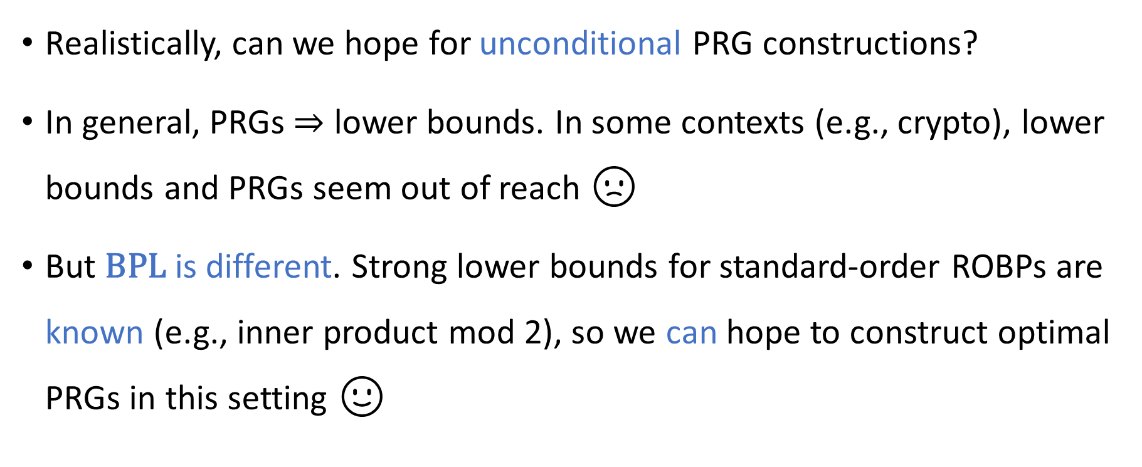
PRGs and lower bounds
Realistically, can we hope for unconditional PRG constructions?
In general, PRGs $⇒$ lower bounds. In some contexts (e.g., crypto), lower bounds and PRGs seem out of reach 🙁
But $\text{BPL}$ is different. Strong lower bounds for standard-order ROBPs are known (e.g., inner product mod 2), so we can hope to construct optimal PRGs in this setting 🙂

Slide 12
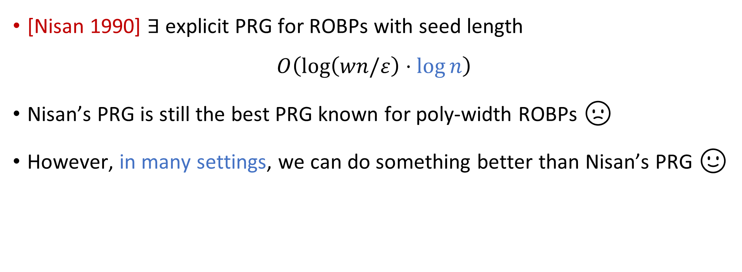
Unconditional PRGs for ROBPs
[Nisan 1990] $∃$ explicit PRG for ROBPs with seed length
$$O\left(\log\left(wn/ε\right)⋅\log{n}\right)$$
Nisan’s PRG is still the best PRG known for poly-width ROBPs 🙁
However, in many settings, we can do something better than Nisan’s PRG 🙂

Slide 13
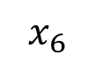
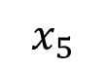
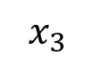
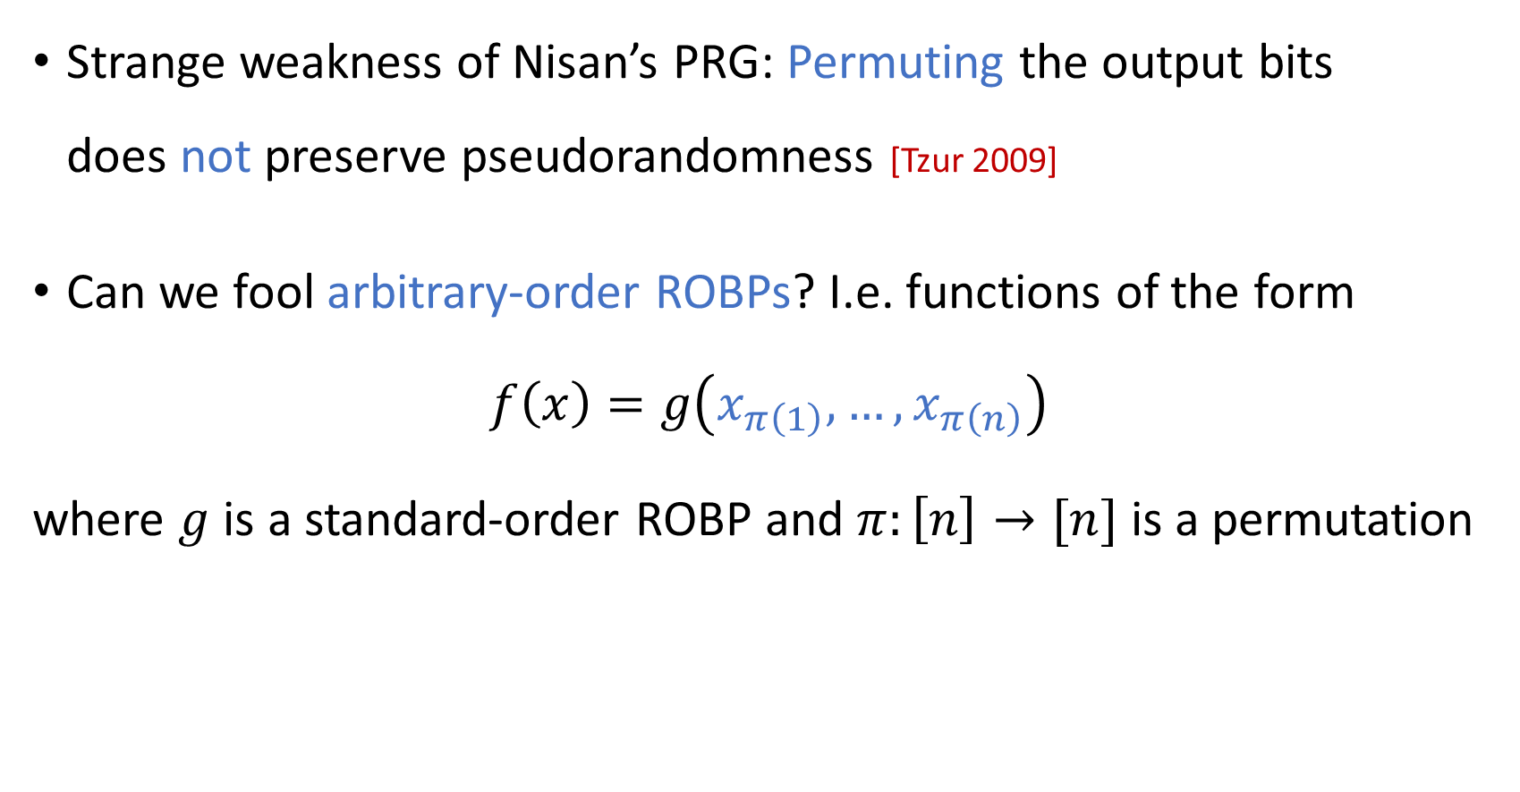
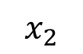
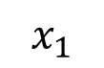
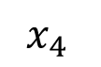
Variable ordering
🔀
Strange weakness of Nisan’s PRG: Permuting the output bits does not preserve pseudorandomness [Tzur 2009]
Can we fool arbitrary-order ROBPs? I.e. functions of the form
$$f\left(x\right)=g\left(x_{π\left(1\right)},…,x_{π\left(n\right)}\right)$$
where $g$ is a standard-order ROBP and $π:\left[n\right]→[n]$ is a permutation
$$x_{5}$$
$$x_{4 }$$
$$x_{1}$$
$$x_{2}$$
$$x_{3}$$
$$x_{6}$$

Slide 14
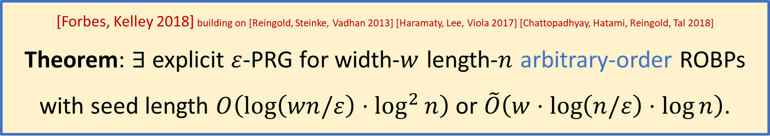
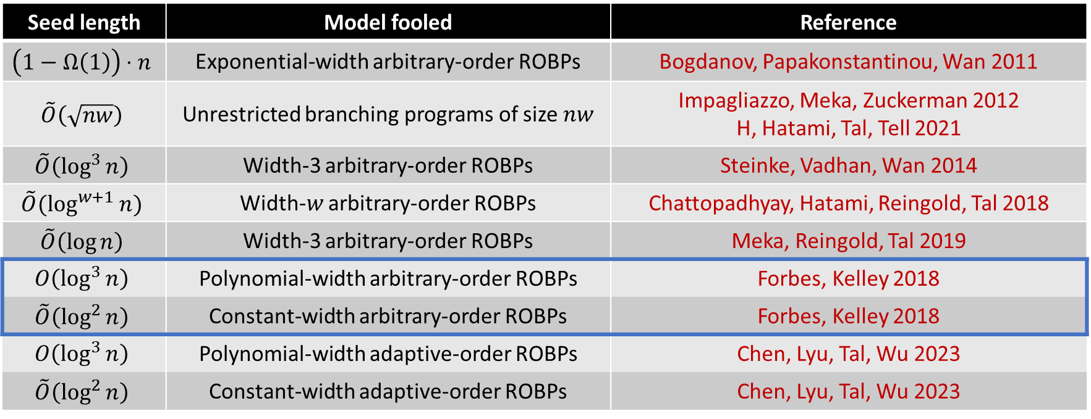
Seed length | Model fooled | Reference
$$\left(1−Ω\left(1\right)\right)⋅n$$ | Exponential-width arbitrary-order ROBPs | Bogdanov, Papakonstantinou, Wan 2011
$$\tilde{O}\left(\sqrt{nw}\right)$$ | Unrestricted branching programs of size $nw$ | Impagliazzo, Meka, Zuckerman 2012 H, Hatami, Tal, Tell 2021
$$\tilde{O}\left(\log^{3}{n}\right)$$ | Width-3 arbitrary-order ROBPs | Steinke, Vadhan, Wan 2014
$$\tilde{O}(\log^{w+1}{n})$$ | Width-$w$ arbitrary-order ROBPs | Chattopadhyay, Hatami, Reingold, Tal 2018
$$\tilde{O}\left(\log{n}\right)$$ | Width-3 arbitrary-order ROBPs | Meka, Reingold, Tal 2019
$$O\left(\log^{3}{n}\right)$$ | Polynomial-width arbitrary-order ROBPs | Forbes, Kelley 2018
$$\tilde{O}\left(\log^{2}{n}\right)$$ | Constant-width arbitrary-order ROBPs | Forbes, Kelley 2018
$$O\left(\log^{3}{n}\right)$$ | Polynomial-width adaptive-order ROBPs | Chen, Lyu, Tal, Wu 2023
$$\tilde{O}\left(\log^{2}{n}\right)$$ | Constant-width adaptive-order ROBPs | Chen, Lyu, Tal, Wu 2023
[Forbes, Kelley 2018] building on [Reingold, Steinke, Vadhan 2013] [Haramaty, Lee, Viola 2017] [Chattopadhyay, Hatami, Reingold, Tal 2018] Theorem: $∃$ explicit $ε$-PRG for width-$w$ length-$n$ arbitrary-order ROBPs with seed length $O\left(\log\left(wn/ε\right)⋅\log^{2}{n}\right)$ or $\tilde{O}\left(w⋅\log\left(n/ε\right)⋅\log{n}\right)$.

Slide 15





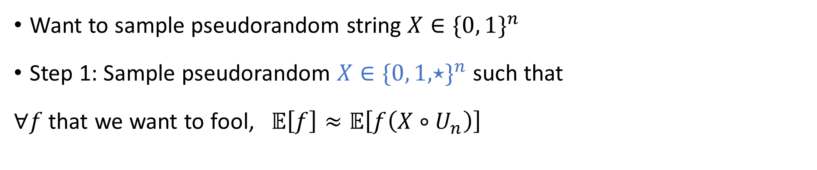



Iterated restriction framework [Ajtai, Wigderson 1985]
Want to sample pseudorandom string $X∈\{0, 1\}^{n}$
Step 1: Sample pseudorandom $X∈\{0, 1, ⋆\}^{n}$ such that
$∀f$ that we want to fool, $𝔼\left[f\right]≈𝔼\left[f\left(X∘U_{n}\right)\right]$
$$≈$$
$$⋆$$
$$⋆$$
$$⋆$$
$$⋆$$
$$⋆$$
$$≈$$
$$≈$$

Slide 16



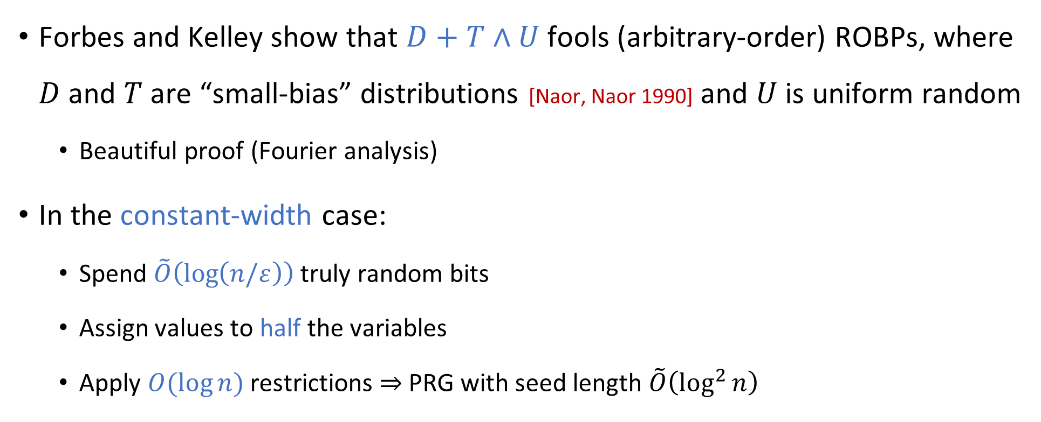


Forbes-Kelley pseudorandom restrictions
$$⋆$$
$$⋆$$
$$⋆$$
$$⋆$$
$$⋆$$
Forbes and Kelley show that $D+T∧U$ fools (arbitrary-order) ROBPs, where $D$ and $T$ are “small-bias” distributions [Naor, Naor 1990] and $U$ is uniform random
Beautiful proof (Fourier analysis)
In the constant-width case:
Spend $\tilde{O}\left(\log\left(n/ε\right)\right)$ truly random bits
Assign values to half the variables
Apply $O(\log{n})$ restrictions $⇒$ PRG with seed length $\tilde{O}\left(\log^{2}{n}\right)$

Slide 17
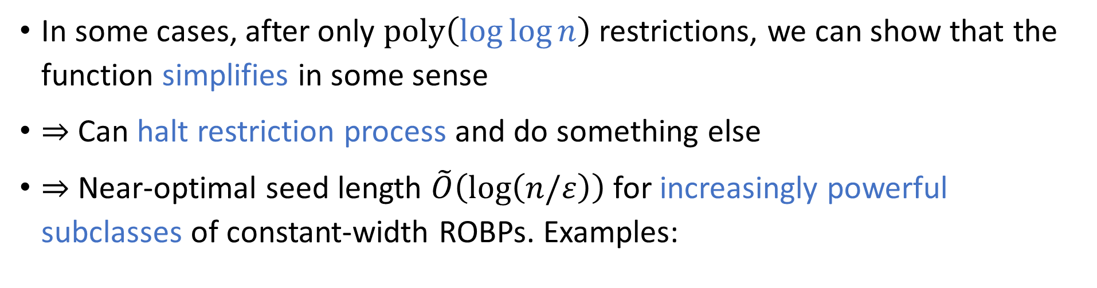
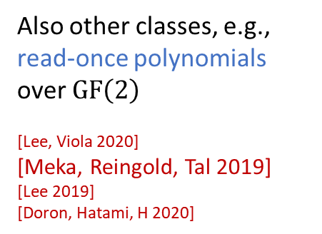


Early termination [Gopalan, Meka, Reingold, Trevisan, Vadhan 2012]
In some cases, after only $\text{poly}\left(\log{\log{n}}\right)$ restrictions, we can show that the function simplifies in some sense
$⇒$ Can halt restriction process and do something else
$⇒$ Near-optimal seed length $\tilde{O}\left(\log\left(n/ε\right)\right)$ for increasingly powerful subclasses of constant-width ROBPs. Examples:
Switching lemma
Constant-width monotone ROBPs [Doron, Meka, Reingold, Tal, Vadhan 2021]
$$⊆$$
Also other classes, e.g., read-once polynomials over $\text{GF}\left(2\right)$
[Lee, Viola 2020] [Meka, Reingold, Tal 2019] [Lee 2019] [Doron, Hatami, H 2020]
Read-once ${\text{AC}}^{0}$ [Chen, Steinke, Vadhan 2015] [Doron, Hatami, H 2019]
$$⊆$$
Read-once CNFs [De, Etesami, Trevisan, Tulsiani 2010] [Gopalan, Meka, Reingold, Trevisan, Vadhan 2012] [Doron, Hatami, H 2020]

Slide 18
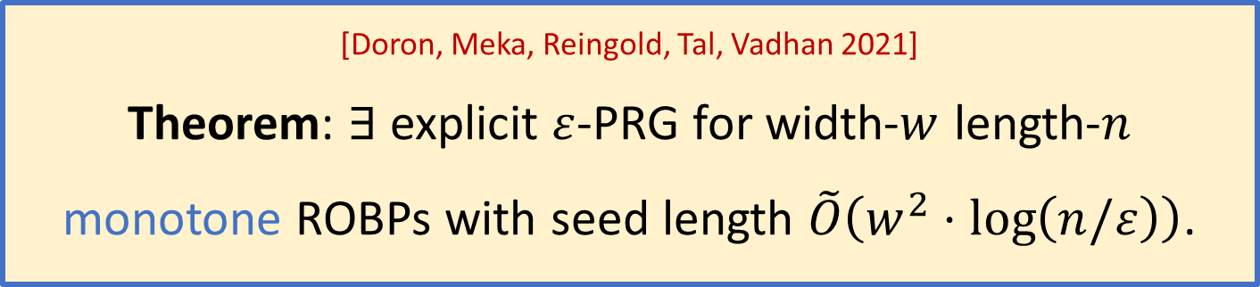
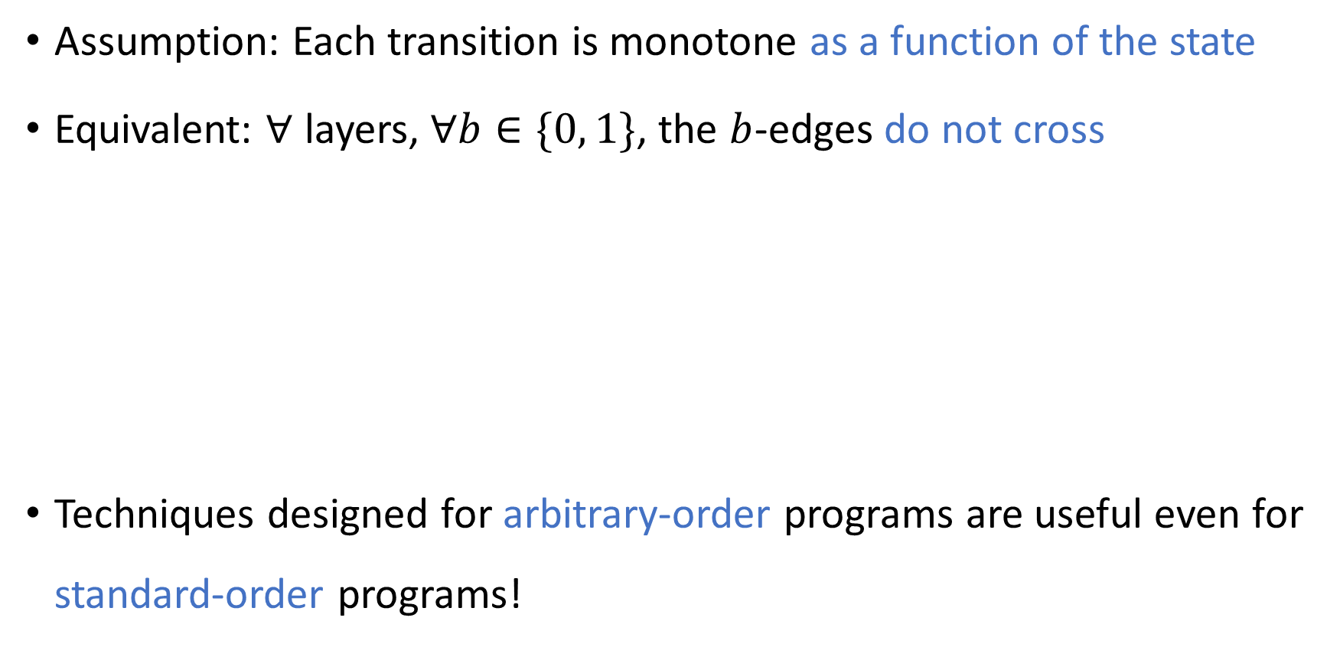
Monotone ROBPs [Meka, Zuckerman 2010]
0
Assumption: Each transition is monotone as a function of the state
Equivalent: $∀$ layers, $∀b∈\{0, 1\}$, the $b$-edges do not cross
Techniques designed for arbitrary-order programs are useful even for standard-order programs!
0
0
[Doron, Meka, Reingold, Tal, Vadhan 2021] Theorem: $∃$ explicit $ε$-PRG for width-$w$ length-$n$ monotone ROBPs with seed length $\tilde{O}\left(w^{2}⋅\log\left(n/ε\right)\right)$.
0
0

Slide 19

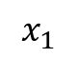
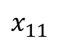
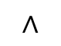
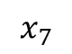

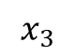
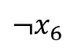
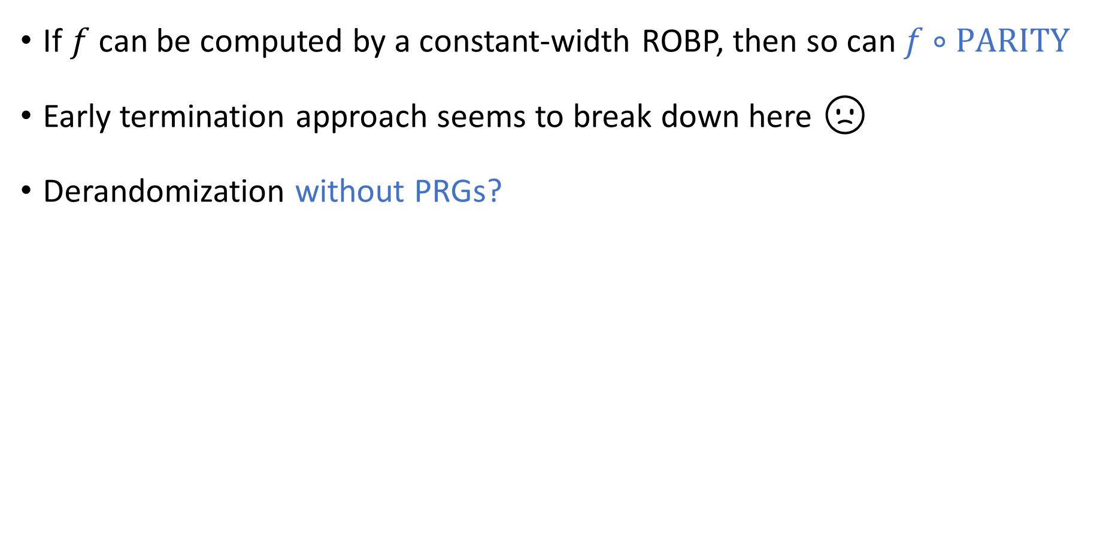
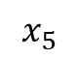
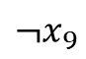



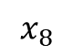

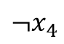

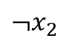
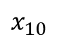
Challenge: Parity gates
If $f$ can be computed by a constant-width ROBP, then so can $f∘\text{PARITY}$
Early termination approach seems to break down here 🙁
Derandomization without PRGs?
$$∧$$
$$∨$$
$$∨$$
$$⊕$$
$$⊕$$
$$⊕$$
$$⊕$$
$$⊕$$
$$x_{3}$$
$$x_{1}$$
$${¬x}_{2}$$
$$x_{8}$$
$${¬x}_{6}$$
$$x_{5}$$
$$x_{11}$$
$${¬x}_{4}$$
$${¬x}_{9}$$
$$x_{7}$$
$$x_{10}$$

Slide 20
Approach 2: Spectral Graph Theory

Slide 21
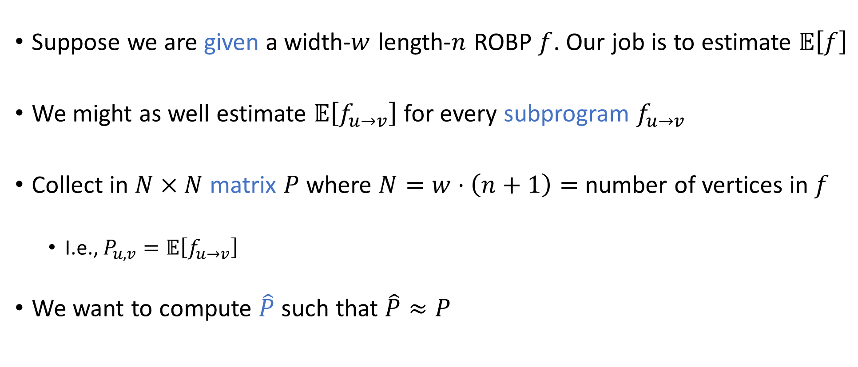
Matrix of expectations of subprograms
Suppose we are given a width-$w$ length-$n$ ROBP $f$. Our job is to estimate $𝔼\left[f\right]$
We might as well estimate $𝔼\left[f_{u→v}\right]$ for every subprogram $f_{u→v}$
Collect in $N×N$ matrix $P$ where $N=w⋅\left(n+1\right)=$ number of vertices in $f$
I.e., $P_{u,v}=𝔼\left[f_{u→v}\right]$
We want to compute $\hat{P}$ such that $\hat{P}≈P$

Slide 22
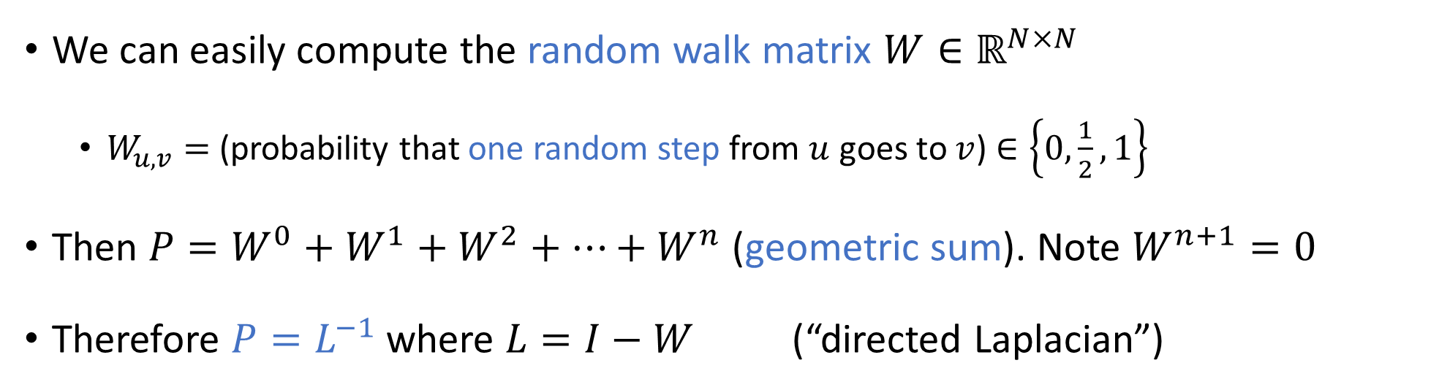
Inverse Laplacian perspective
[Ahmadinejad, Kelner, Murtagh, Peebles, Sidford, Vadhan 2020]
We can easily compute the random walk matrix $W∈ℝ^{N×N}$
$W_{u,v}=$ (probability that one random step from $u$ goes to $v$) $∈\left\{0,\frac{1}{2},1\right\}$
Then $P=W^{0}+W^{1}+W^{2}+⋯+W^{n}$ (geometric sum). Note $W^{n+1}=0$
Therefore $P=L^{−1}$ where $L=I−W$ (“directed Laplacian”)
So our job is to find $\hat{P}$ such that $\hat{P}≈L^{−1}$ (approximate inverse Laplacian)

Slide 23
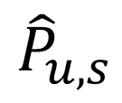
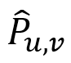
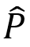


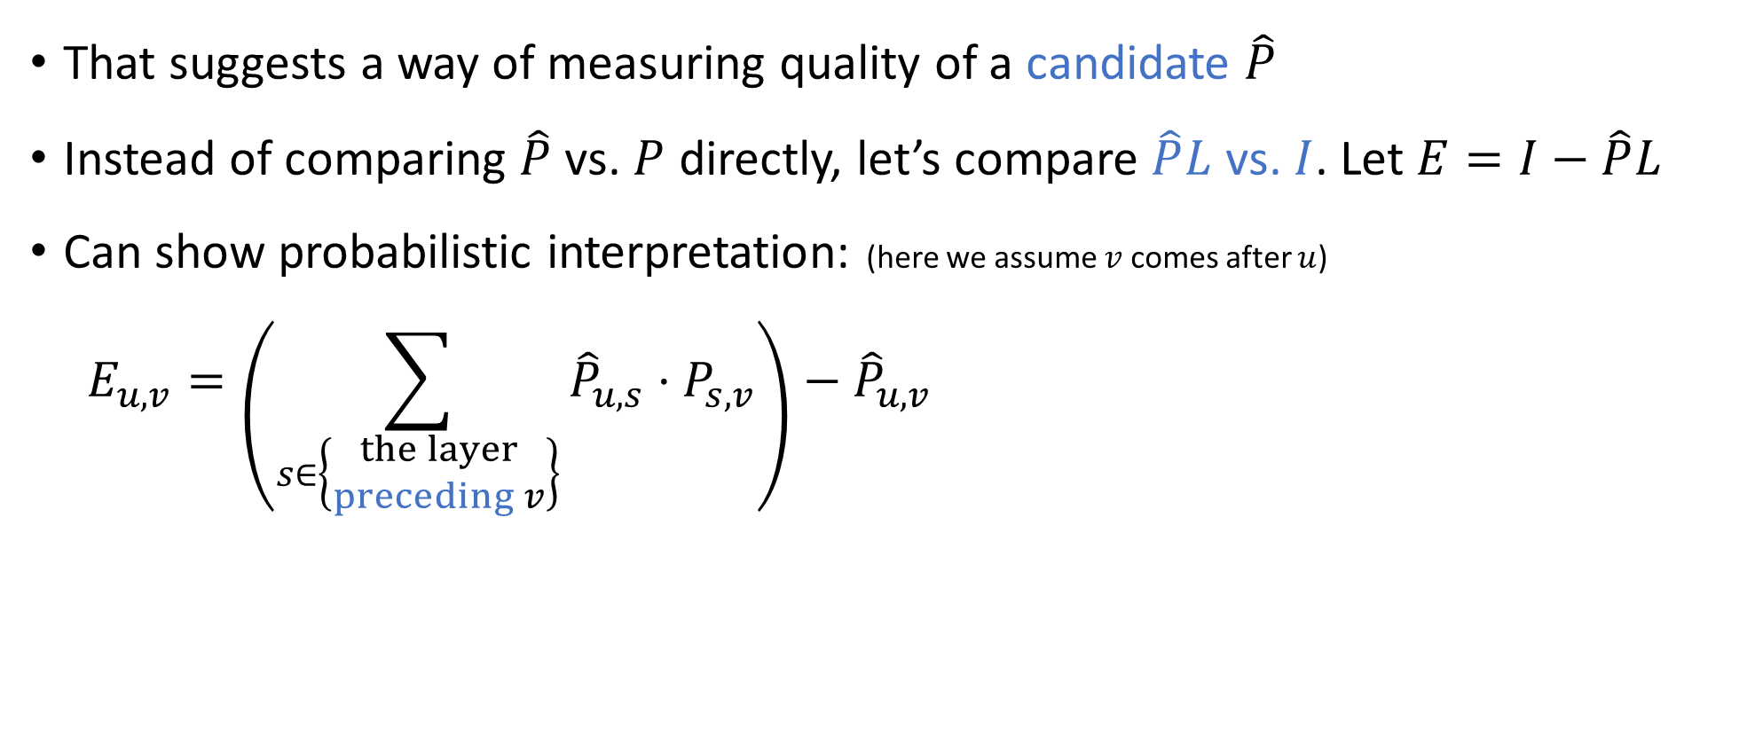

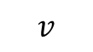

Local consistency
So our job is to find $\hat{P}$ such that $\hat{P}≈L^{−1}$ (approximate inverse Laplacian)
That suggests a way of measuring quality of a candidate $\hat{P}$
Instead of comparing $\hat{P}$ vs. $P$ directly, let’s compare $\hat{P}L$ vs. $I$. Let $E=I−\hat{P}L$
Can show probabilistic interpretation: (here we assume $v$ comes after $u$)
$$E_{u,v}=\left(\sum_{s∈\left\{\begin{matrix}the layer \\ preceding v\end{matrix}\right\}}{{\hat{P}}_{u,s}⋅P_{s,v}}\right)−{\hat{P}}_{u,v}$$
$$v$$
0.4
0.49
$≈$ 0.5 ✔
$$u$$
$$⋯$$
0.5
“Local consistency error” [Cheng, H 2020]
Two different ways of using $\hat{P}$ to estimate $P_{u,v}$
0.1

Slide 24


Application: Non-black-box error reduction
Problem: Given a width-$n$ length-$n$ ROBP $f$ as input, estimate $𝔼[f]$
Assume we can compute $𝔼\left[f\right]±1/\text{poly}(n)$ deterministically in space $S\left(n\right)$
[Ahmadinejad, Kelner, Murtagh, Peebles, Sidford, Vadhan 2020] strengthening [H, Zuckerman 2018]
Theorem: Can compute $𝔼\left[f\right]±ε$ deterministically in space
$$O\left(S\left(n\right)+\log{n}⋅\log{\log_{n}\left(1/ε\right)}\right)$$

Slide 25


Richardson iteration
[Ahmadinejad, Kelner, Murtagh, Peebles, Sidford, Vadhan 2020]
In space $O\left(S\left(n\right)\right)$, compute $\hat{P}$ such that $\left\|P−\hat{P}\right\|≤1/\text{poly}\left(n\right)$
$\hat{P}L=I−E$ where $E$ (local consistency errors) satisfies ${\left\|E\right\|}_{∞}≤1/\text{poly}\left(n\right)$ 🚶
Define $\hat{\hat{P}}=\hat{P}+E\hat{P}+E^{2}\hat{P}+⋯+E^{m}\hat{P}$ 🏋️
$$\hat{\hat{P}}L=\left(I−E\right)+E⋅\left(I−E\right)+E^{2}⋅\left(I−E\right)+⋯+E^{m}⋅\left(I−E\right) \\ =(I−E) + \left(E−E^{2}\right) + \left(E^{2}−E^{3}\right)+⋯+\left(E^{m}−E^{m+1}\right)=I−E^{m+1}$$
For $m=O\left(\frac{\log\left(1/ε\right)}{\log{n}}\right)$, we get
$\left|{\hat{\hat{P}}}_{u,v}−P_{u,v}\right|≤{\left\|\hat{\hat{P}}LP−P\right\|}_{∞}≤{\left\|\hat{\hat{P}}L−I\right\|}_{∞}⋅{\left\|P\right\|}_{∞}≤\frac{O\left(n\right)}{n^{O\left(m\right)}}≤ε$ 💪
Low-error approximate inverse of $L$

Slide 26

Revisiting black-box derandomization
How to estimate $𝔼\left[f\right]±ε$ when we only have query access to $f$?
An $ε$-error PRG would suffice… how about something easier to construct?

Slide 27

Weighted pseudorandom generators (WPRGs)
Pair $(G, ρ)$, where $G:\{0, 1\}^{s}→\{0, 1\}^{n}$ and $ρ:\{0, 1\}^{s}→ℝ$
Requirement: $∀$ width-$w$ length-$n$ ROBP $f$,
$$\left|𝔼_{x}\left[f\left(G\left(x\right)\right)⋅ρ(x)\right]−𝔼\left[f\right]\right|≤ε$$
Introduced a few years ago [Braverman, Cohen, and Garg 2018]
Aka “pseudorandom pseudodistribution generator”

Slide 28

Hitting set generators (HSGs)
Hitting set generator (HSG): Function $G:\{0, 1\}^{s}→\{0, 1\}^{n}$ such that for every width-$w$ length-$n$ standard-order ROBP $f$, $\text{if} 𝔼\left[f\right]>ε, \text{then} ∃x \text{such} \text{that} f\left(G\left(x\right)\right)=1$
PRG $⇒$ WPRG $⇒$ HSG
WPRGs and HSGs are potentially easier to construct compared to PRGs
HSG
WPRG
PRG

Slide 29






Generators for width-$n$ length-$n$ ROBPs
Seed length | Type of generator | Reference
$$\tilde{O}\left(\sqrt{n}\right)+O\left(\log\left(1/ε\right)\right)$$ | HSG | Ajtai, Komlós, Szemerédi 1987
$$2^{O\left(\sqrt{\log{n}}\right)}⋅log⁡(1/ε)$$ | PRG | Babai, Nisan, Szegedy 1989
$$O\left(\log^{2}{n}+\log{n}⋅\log\left(1/ε\right)\right)$$ | PRG | Nisan 1990, …
$$\tilde{O}\left(\log^{2}{n}+\log\left(1/ε\right)\right)$$ | WPRG | Braverman, Cohen, Garg 2018
$$O(\log^{2}{n}+\log\left(1/ε\right))$$ | HSG | H, Zuckerman 2018
$$\tilde{O}\left(\log^{2}{n}\right)+O(\log\left(1/ε\right))$$ | WPRG | Chattopadhyay, Liao 2020
$$O\left(\log^{2}{n}\right)+\tilde{O}\left(\log\left(1/ε\right)\right)$$ | WPRG | Cohen, Doron, Renard, Sberlo, Ta-Shma 2021 and Pyne, Vadhan 2021
$$O(\log^{2}{n}+\log\left(1/ε\right))$$ | WPRG | H 2021

Slide 30




Low-error WPRGs for ROBPs
[H 2021] building on [Cohen, Doron, Renard, Sberlo, Ta-Shma 2021] [Pyne, Vadhan 2021] [Ahmadinejad, Kelner, Murtagh, Peebles, Sidford, Vadhan 2020]
Theorem: $∃$ explicit WPRG for width-$n$ length-$n$ standard-order ROBPs with seed length $O\left(\log^{2}{n}+\log\left(1/ε\right)\right)$
More generally, we have an error-reduction procedure:
Based on Richardson iteration (& sampler trick)
Moderate-error PRG
Fools width-$w$ length-$n$ ROBPs
Error $1/\text{poly}\left(wn\right)$
Seed length $s$
Low-error WPRG
Fools width-$w$ length-$n$ ROBPs
Error $ε$
Seed length $O\left(s+\log\left(1/ε\right)\right)$
$$⇒$$

Slide 31
The role of WPRGs and HSGs
What exactly are WPRGs and HSGs good for?
What do these concepts buy us?

Slide 32


Derandomization given an optimal HSG
Given an optimal HSG, it is straightforward to derandomize algorithms that have one-sided error ($\text{L}=\text{RL}$)
(Note: The analogous theorem for $\text{BPP}$ has been known since the 1990s, but the known proofs for the $\text{BPP}$ case don’t preserve the read-once condition)
[Cheng, H 2020] (see also [Pyne, Raz, Zhan 2023])
Theorem: If $∃$ log-space HSG for width-$n$ length-$n$ standard-order ROBPs with seed length $O\left(\log{n}\right)$, then $\text{L}=\text{BPL}$

Slide 33



Derandomizing $\text{BPL}$ given an HSG
[Cheng, H 2020] (see also [Pyne, Raz, Zhan 2023])
Theorem: If $∃$ log-space HSG for width-$n$ length-$n$ standard-order ROBPs with seed length $O\left(\log{n}\right)$, then $\text{L}=\text{BPL}$
Proof idea: Use HSG $G$ with output length $n^{c}$ to analyze ROBP of length $n$
Think of $G\left(x\right)$ as a long stream of random bits and use it to compute ${\hat{P}}^{\left(x\right)}$
Using the hitting property, one can show $∃x$ such that ${\hat{P}}^{\left(x\right)}≈L^{−1}$
Algorithm: Find $x$ such that ${\hat{P}}^{\left(x\right)}$ has good local consistency

Slide 34

WPRGs vs. HSGs
HSGs can derandomize $\text{BPL}$
Do WPRGs have value above and beyond the value of HSGs?

Slide 35



Application: Better derandomization of $\text{BPL}$
Deterministic space | Model simulated | Reference
$$O\left(S^{2}\right)$$ | $$\text{NSPACE}(S)$$ | Savitch 1969
$$O\left(S^{2}\right)$$ | Non-halting unbounded-error randomized space-$S$ | Jung 1981 and Borodin, Cook, Pippenger 1983
$$O\left(S^{3/2}\right)$$ | $$\text{BPSPACE}(S)$$ | Saks, Zhou 1995
$$O\left(S^{3/2}/\sqrt{\log{S}}\right)$$ | $$\text{BPSPACE}(S)$$ | H 2021
[H 2021] building on [Cohen, Doron, Renard, Sberlo, Ta-Shma 2021] [Pyne, Vadhan 2021] [Chattopadhyay, Liao 2020] [Armoni 1998] [Saks, Zhou 1995] Theorem: $∀S=S\left(n\right)≥\log{n}$, $\text{BPSPACE}(S)⊆\text{DSPACE}\left(S^{3/2}/\sqrt{\log{S}}\right)$
Proof uses WPRG error reduction (and other ingredients)

Slide 36

Regular ROBPs & permutation ROBPs
Spectral methods work especially well for the special cases of regular ROBPs and permutation ROBPs
Permutation condition: $∀$ layers, $∀b∈\{0, 1\}$, the $b$-edges are a matching
Permutation $⇒$ “regular” (degree = 2)
0
0
0
0
0

Slide 37

Generators for narrow regular/permutation ROBPs
Seed length | Type | Model | Reference
$$\tilde{O}\left(\log{n}⋅\log\left(1/ε\right)\right)$$ | PRG | Polylog-width regular ROBPs | [Braverman, Rao, Raz, Yehudayoff 2010] [De 2011]
$$O\left(\log{n}⋅\log\left(1/ε\right)\right)$$ | PRG | Constant-width permutation ROBPs | [Brody, Verbin 2010] [Koucký, Nimbhorkar, Pudlák 2011] [De 2011] [Steinke 2012]
$$\tilde{O}\left(\log{n}⋅\log\left(1/ε\right)\right)$$ | PRG | Constant-width arbitrary-order permutation ROBPs | [Reingold, Steinke, Vadhan 2013] [Chattopadhyay, Hatami, Hosseini, Lovett 2018] [Lee, Pyne, Vadhan 2022]
$$\tilde{O}\left(\log{n}⋅\sqrt{\log\left(1/ε\right)}+\log\left(1/ε\right)\right)$$ | HSG | Polylog-width regular ROBPs | [Bogdanov, H, Prakriya, Pyne 2021]
$$\tilde{O}\left(\log{n}⋅\sqrt{\log\left(1/ε\right)}+\log\left(1/ε\right)\right)$$ | WPRG | Polylog-width regular ROBPs | [Chen, H, Lyu, Tal, Wu 2023] [Chattopadhyay, Liao 2024]
Almost all of these results build on the INW PRG, which is based on spectral expander graphs [Impagliazzo, Nisan, Wigderson 1994]

Slide 38


Motivation: Reduction to the regular case
Let $f:\{0, 1\}^{n}→\{0, 1\}$
Can we derandomize polynomial-width regular ROBPs?
[Lee, Pyne, Vadhan 2023] strengthening [Reingold, Trevisan, Vadhan 2006] and [Bogdanov, H, Prakriya, Pyne 2022] Theorem: If $f$ can be computed by a standard-order ROBP of width $w$, then $f$ can also be computed by a standard-order regular ROBP of width $O\left(wn\right)$.

Slide 39

Non-black-box derandomization of regular ROBPs
[Ahmadinejad, Kelner, Murtagh, Peebles, Sidford, Vadhan 2020] building on [Murtagh, Reingold, Sidford, Vadhan 2017] [ — 2019]
Subsequent simpler proofs: [Chen, H, Lyu, Tal, Wu 2023] [Chattopadhyay, Liao 2024]
Theorem: Given a standard-order width-$w$ length-$n$ regular ROBP $f$, it is possible to deterministically estimate $𝔼\left[f\right]±ε$ using $\tilde{O}\left(\log\left(wn\right)⋅\log{\log\left(1/ε\right)}\right)$ bits of space
Proof uses inverse Laplacian perspective (Richardson iteration, etc.)
Note: Reduction from general case to regular case is not space-efficient 🙁
Reduction is only compatible with black-box derandomization

Slide 40


Generators for wide regular/permutation ROBPs
Recent trend: Study “width-$∞$” programs with only one accepting vertex
Strange model that challenges our intuitions
Seed length | Type | Model | Reference
$$\tilde{O}\left(\log{n}⋅\log\left(1/ε\right)\right)$$ | PRG | Unbounded-width permutation ROBPs | [H, Pyne, Vadhan 2021]
$$\tilde{O}\left(\log{n}⋅\sqrt{\log\left(1/ε\right)}+\log\left(1/ε\right)\right)$$ | WPRG | Unbounded-width permutation ROBPs | [Pyne, Vadhan 2021] [Chen, H, Lyu, Tal, Wu 2023] [Chattopadhyay, Liao 2024]
$$\tilde{O}\left(\log{n}⋅\log\left(1/ε\right)\right)$$ | HSG | Unbounded-width regular ROBPs | [Bogdanov, H, Prakriya, Pyne 2021]
$$\left(1−Ω\left(1\right)\right)⋅n$$ | PRG | Unbounded-width arbitrary-order permutation ROBPs | [Lee, Pyne, Vadhan 2022]
$$\text{polylog}\left(n/ε\right)$$ | PRG | Unbounded-width arbitrary-order permutation ROBPs | [Chen, Lyu, Tal, Wu 2023]
$$\tilde{O}\left(\sqrt{n⋅\log\left(1/ε\right)}+\log\left(1/ε\right)\right)$$ | PRG | Unbounded-width arbitrary-order regular ROBP | [Chen, Lyu, Tal, Wu 2023]

Slide 41


WPRGs vs. PRGs: An intrinsic separation
[Pyne, Vadhan 2021] [Chen, H, Lyu, Tal, Wu 2023] [Chattopadhyay, Liao 2024] Theorem: $∃$ explicit WPRG that fools unbounded-width single-accept-vertex standard-order permutation ROBPs with error $1/n$ and seed length $\tilde{O}\left(\log^{3/2}{n}\right)$
[H, Pyne, Vadhan 2021] Theorem: $∀$ unweighted PRG that fools unbounded-width single-accept-vertex standard-order permutation ROBPs with error $1/n$, seed length is $Ω\left(\log^{2}{n}\right)$

Slide 42
Recap of the two approaches
Approach 1: Iterated Restrictions
Simplification under restrictions, early termination, …
Arbitrary-order ROBPs, monotone ROBPs, …
Approach 2: Spectral Graph Theory
Inverse Laplacian perspective, Richardson iteration, WPRGs, …
Regular ROBPs, permutation ROBPs, unbounded-width ROBPs, …

Slide 43
Combining the Two Approaches

Slide 44

Combining the two approaches
ROBPs
🔧 Spectral graph theory
Permutation ROBPs
Monotone ROBPs
🔨 Iterated restrictions
🛠️ Can we combine these two sets of techniques to design a PRG for constant-width ROBPs with seed length $\tilde{O}\left(\log{n}\right)$?

Slide 45

Generators for standard-order width-3 ROBPs
Seed length | Type | Approach | Reference
$$\tilde{O}\left(\log\left(n/ε\right)\right)$$ | HSG | Iterated restrictions | Gopalan, Meka, Reingold, Trevisan, Vadhan 2012
$$\tilde{O}\left(\log{n}⋅\log\left(1/ε\right)\right)$$ | PRG | Combination | Meka, Reingold, Tal 2019
$$\tilde{O}\left(\log{n}⋅\sqrt{\log\left(1/ε\right)}+\log\left(1/ε\right)\right)$$ | WPRG | Combination | Chen, H, Lyu, Tal, Wu 2023 (See also Chattopadhyay, Liao 2024)

Slide 46


(W)PRGs for standard-order width-3 ROBPs
[Meka, Reingold, Tal 2019] Theorem: $∃$ explicit PRG for width-3 ROBPs with seed length $\tilde{O}\left(\log{n}⋅\log\left(1/ε\right)\right)$
[Chen, H, Lyu, Tal, Wu 2023] (see also [Chattopadhyay, Liao 2024]) Theorem: $∃$ explicit WPRG for width-3 ROBPs with seed length $$\tilde{O}\left(\log{n}⋅\sqrt{\log\left(1/ε\right)}+\log\left(1/ε\right)\right)$$
Approach: Show that after applying pseudorandom restrictions, w.h.p., the program “almost” becomes a permutation ROBP
We can fool permutation ROBPs using spectral methods (INW, Richardson, etc.)

Slide 47
Conclusions
Lots of exciting results!
Steady, substantial progress!
Thanks for listening!
Come again tomorrow for more!
Questions?

